Slide 1

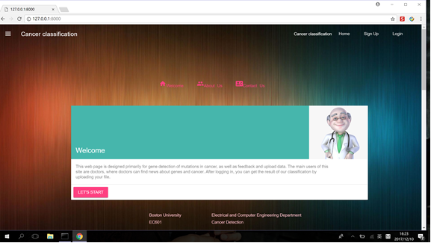
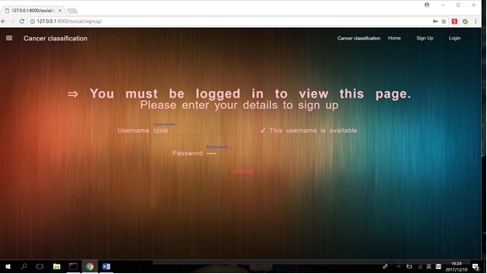
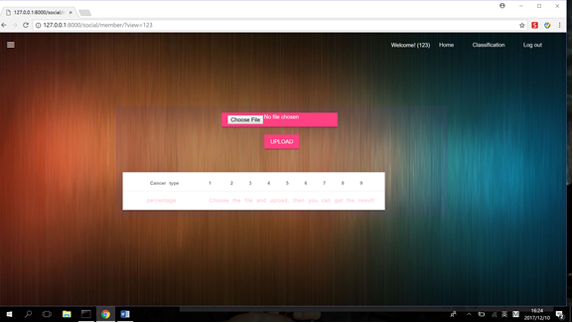

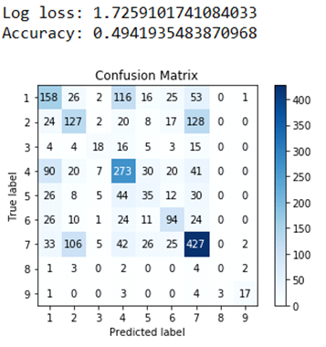
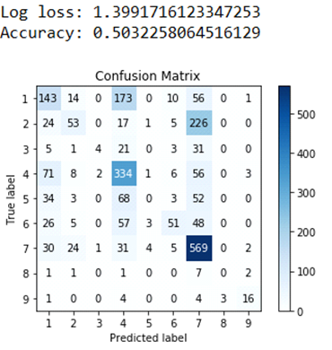
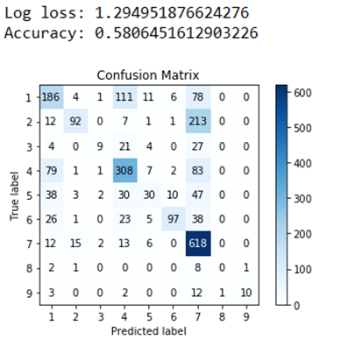
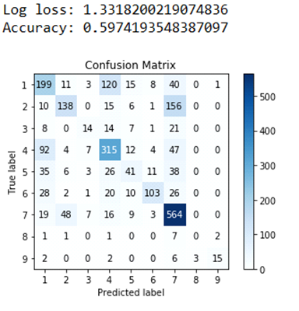
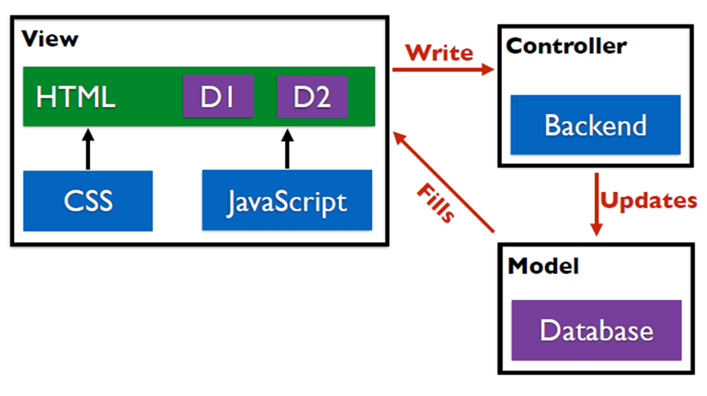
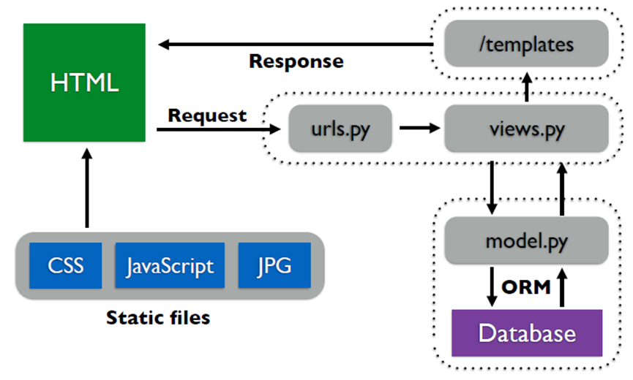

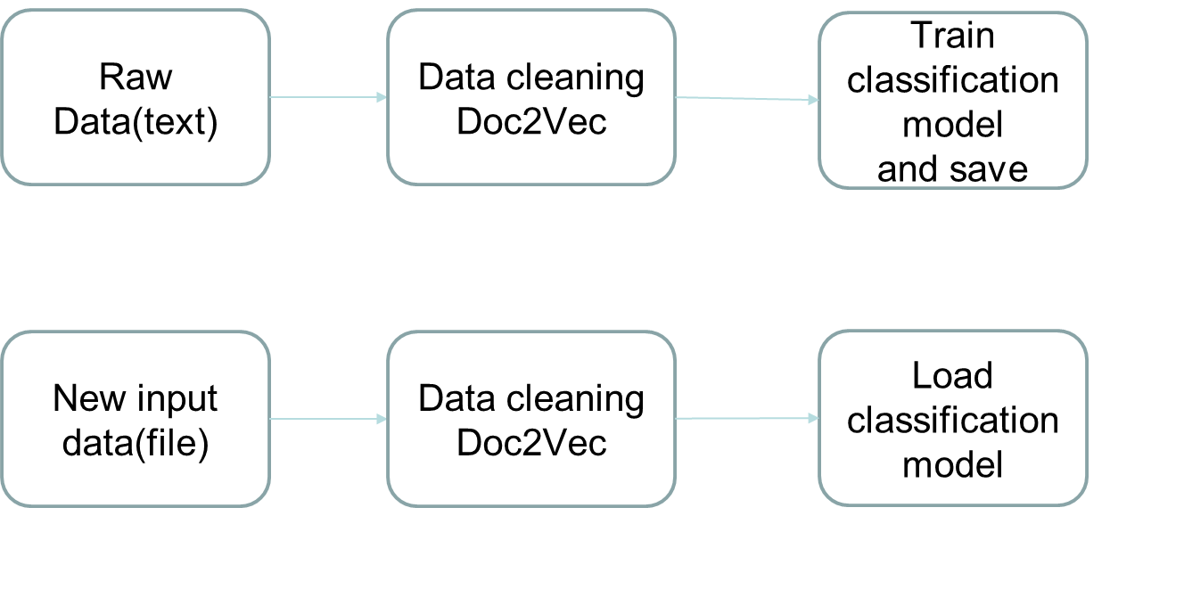
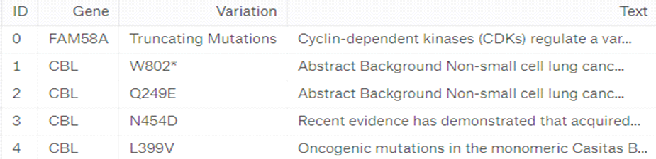
Classification of Cancer Causing Genetic Mutations
Liyi Cao^{1a}, Jiaxin Tang^{1b}, Zisen Zhou^{1c}, Shachi Vaman Khadilkar^{1d}
¹Department of Electrical and Computer Engineering, Boston University, Boston, MA
ªcaoliyi@bu.edu, ^{b}jxtang@bu.edu, ^{c}jason826@bu.edu, ^{d}shachivk@bu.edu
Introduction
Data Analysis
Interface
Cancer is caused by mutations in the genes of a cell. A cancer tumor can have thousands of genetic mutations of which some contribute to growth of the tumor and others do not.
Clinicians interpret the genetic mutations and manually classify them on the basis of evidence from clinical literature which is extremely time consuming.
We have developed a data learning algorithm using data which contains thousands of mutations manually annotated by researchers and oncologists which classifies genetic variations into nine categories.
The gene data consists of four parts: ID, gene, variation and text.
The gene and variation parts are not very relevant with respect to the result, so we only take the text into consideration.
In program 1, we used the text part of raw data and applied text cleaning techniques to them. For example, change the uppercase letters to lower case, wipe out punctuations, etc. Then we trained doc2vec model to get features. As the Doc2Vec model is unsupervised, we combined the train and test data to train the model. Then we set the dimension of features to be 300 and used the features to train the model.
In program 2 which is deployed in the database, we get the input text uploaded by the doctor, use data cleaning and doc2vec, then load the classification model to get the result.
Some comparisons between models:
Logistic Regression SVC RandomforestClassifier XGBClassifier:
We made some comparisons of Randomforest Classifier and XGB Classifier, and finally decided to use Randomforest as it’s accuracy is close to XGB Classifier, and has lower log-loss. Besides, it’s faster.
Let’s try our website:
Click ‘Sign up’ or ‘Let’s Start’ to begin the cancer classification.
After signing up and logging in, you can go to the classification page and upload your file.
You can then see the classification result.
Django Framework
Django is a high-level Python Web framework that encourages rapid development and clean, pragmatic design.
The model part of Django is done by model.py and the Database. By using the SQLite database, the username and password can be saved for user to login. The result of the classification will be saved for each user as well.
The view part in Django is the views.py and the webpage templates. Cancer gene mutations are classified in the views.py. The imported trained model is used to do the classification. The webpage follows the DRY principle.
The control part is the Django framework itself.
MVC & Web Apps MVC for Django
Acknowledgements
We would like to thank Prof. Osama Alshaykh for his guidance, advice and support throughout and also Graduate Teaching Assistants Rishab Shah, Abdullah Gok, Sherman Sze and Jinyuan Zhao for their help and guidance.
GitHub Link
https://github.com/jxtang0920/EC601cancer_detection

